Slide 1
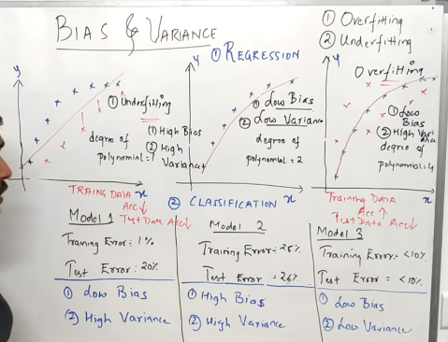
Overfiting
Underfiting
Generalised

